Slide 1
Symbols of Easter
1. Ashes
2. Palm Cross
3. Easter Eggs

Slide 2
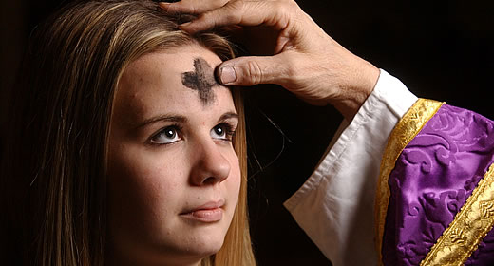
Symbols of Easter
Ashes
Remind us of our Limits – our humanity & frailty

Slide 3

Symbols of Easter
Palm Cross
Remind us of God’s Love

Slide 4
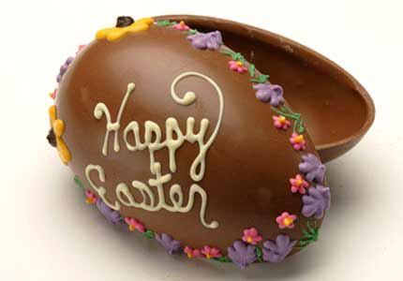
Symbols of Easter
Easter Eggs
Remind us of God’s promise of Life

Slide 5
Symbols of Easter
1. Ashes
Our Limits
God’s Love
2. Palm Cross
3. Easter Eggs
God’s Life

