Slide 1
Stations of the Cross
by Michael Freeman (b 1936)

Slide 2
We are pleased and proud to exhibit these fourteen stations of the cross painted by Michael Freeman, who has kindly allowed us to display his painted stations. They are extraordinary, beautiful and provocative paintings which assist us in our journey of the cross on Good Friday.

Slide 3
My 'Via Crucis', the Fourteen Stations of the Cross, germinated slowly and as a result of my recurring impression that much modern painting of the Christian subjects thoughtlessly re-uses Medieval and Renaissance imagery without deep conviction.

Slide 4
I eventually painted my 'Fourteen Stations' between 1976 and 1978. I painted them as I felt them.
They are painted to focus contemplation on the subjects referred to, not to illustrate those subjects. The changing colour and in one case the absence of the motif in the top part of the picture is significant.

Slide 5
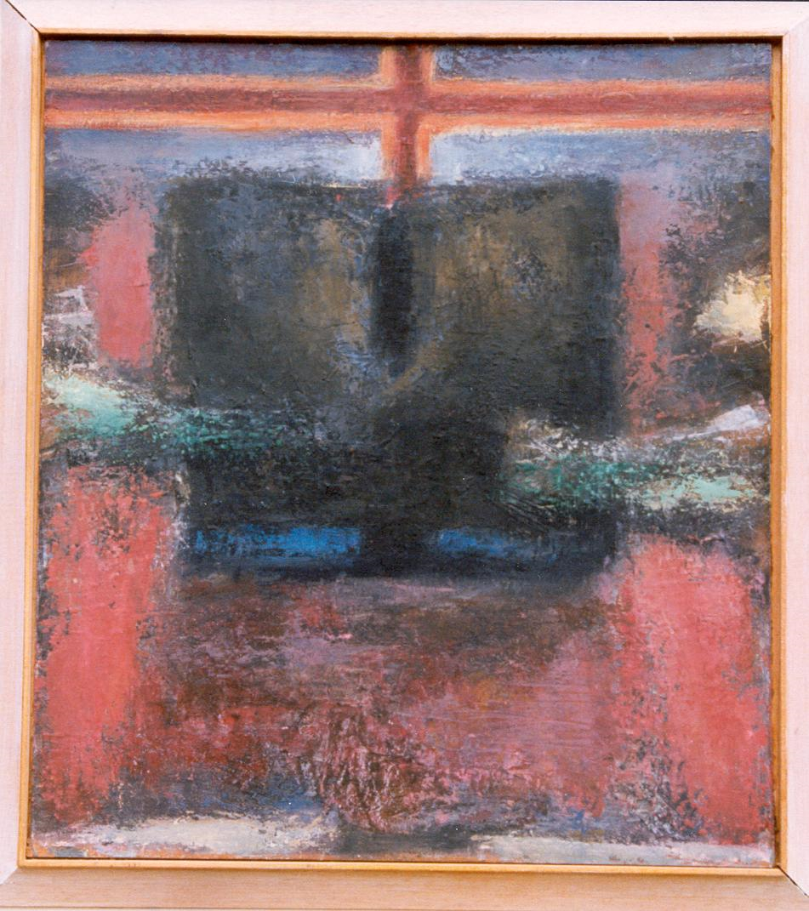
1. Jesus is
condemned to death by Pontius Pilate

Slide 6
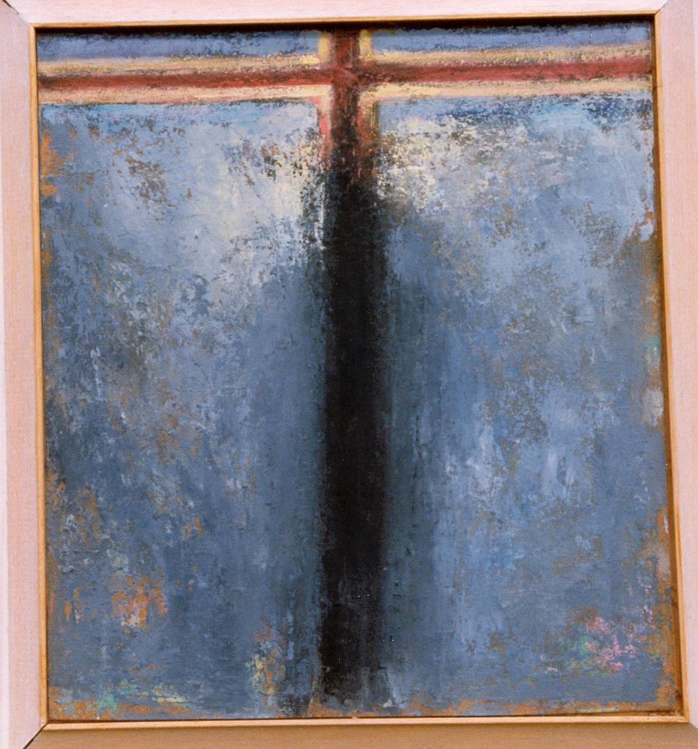
2. Jesus takes his cross

Slide 7
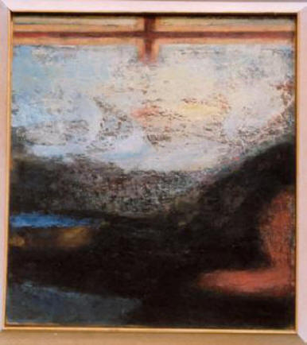
3. Jesus
first fall to the ground

Slide 8
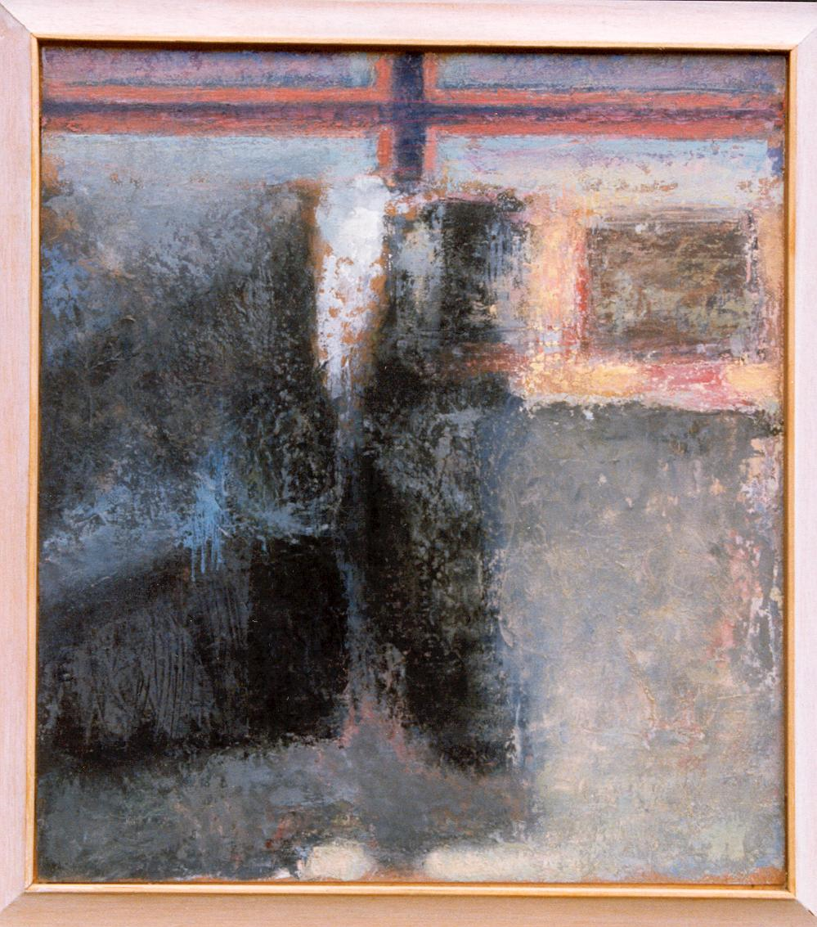
4. Jesus
meets his mother

Slide 9
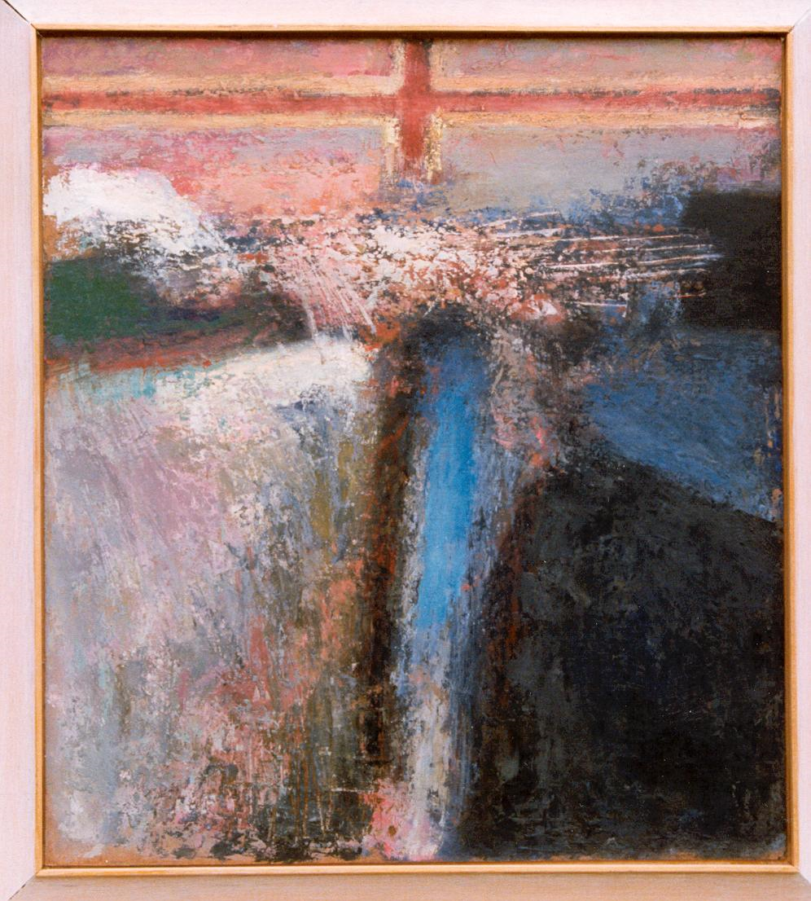
5. Jesus
and Simon of Cyrene who takes his cross

Slide 10
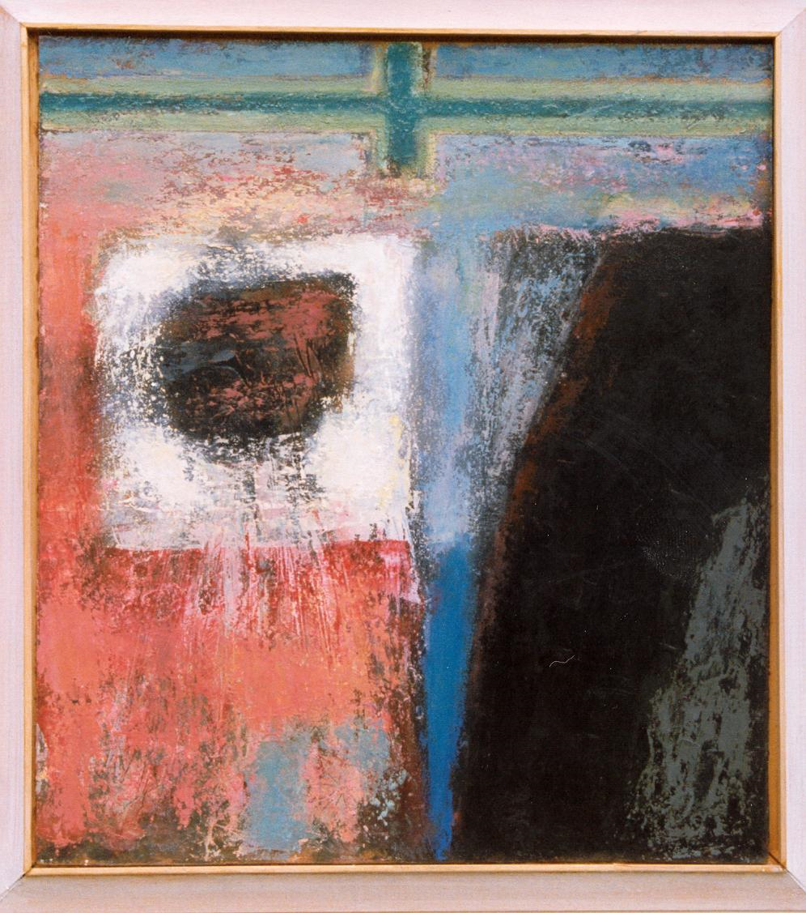
6. Jesus
has his face wiped by
Veronica

Slide 11
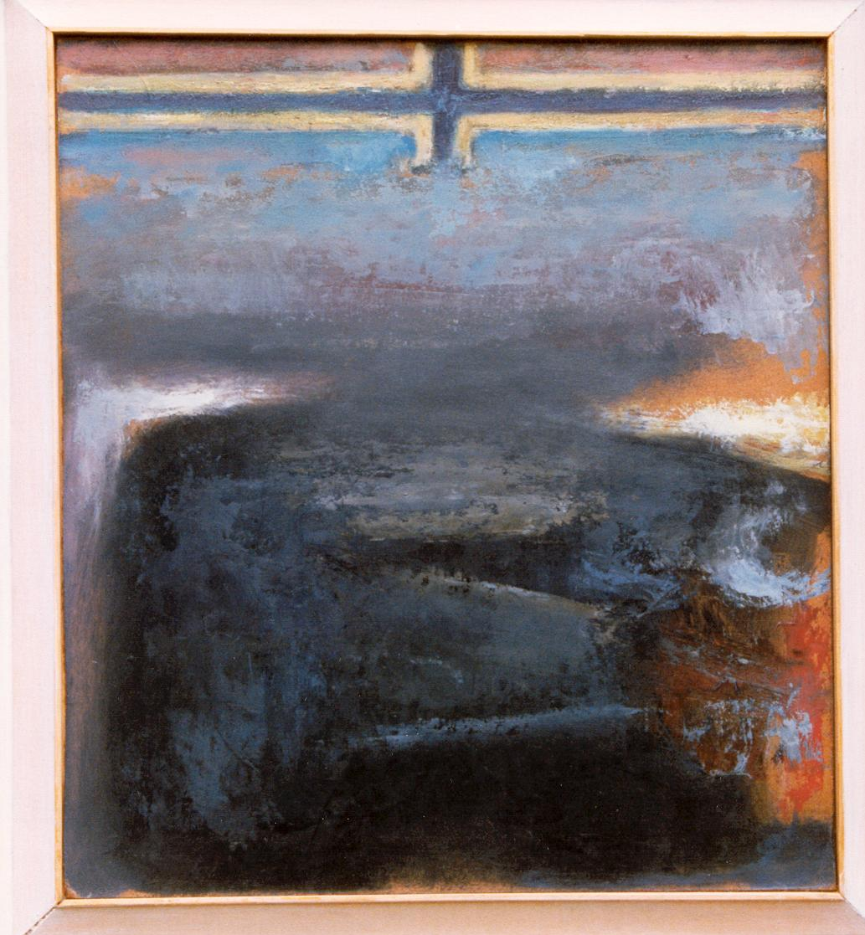
7. Jesus
falls a second
time

Slide 12
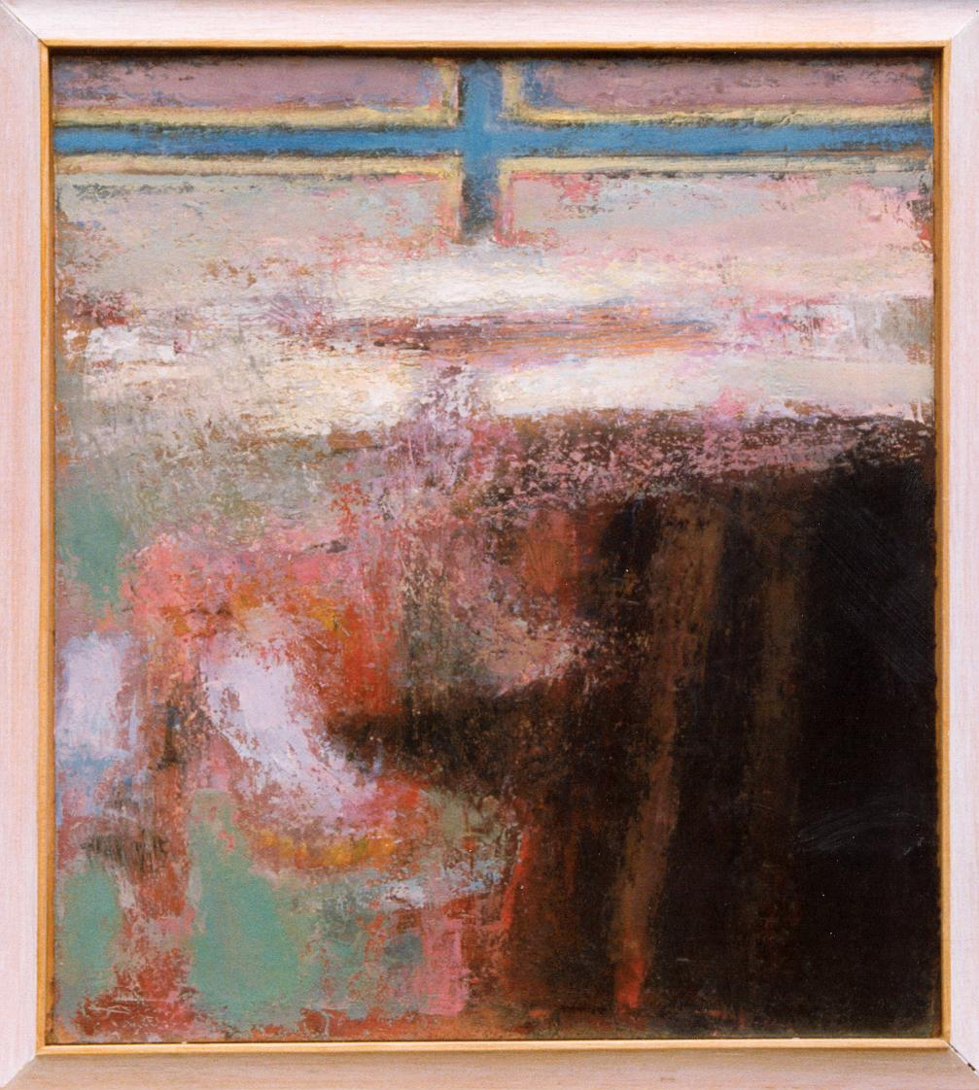
8. Jesus tells the daughters of Jerusalem not to weep for him

Slide 13
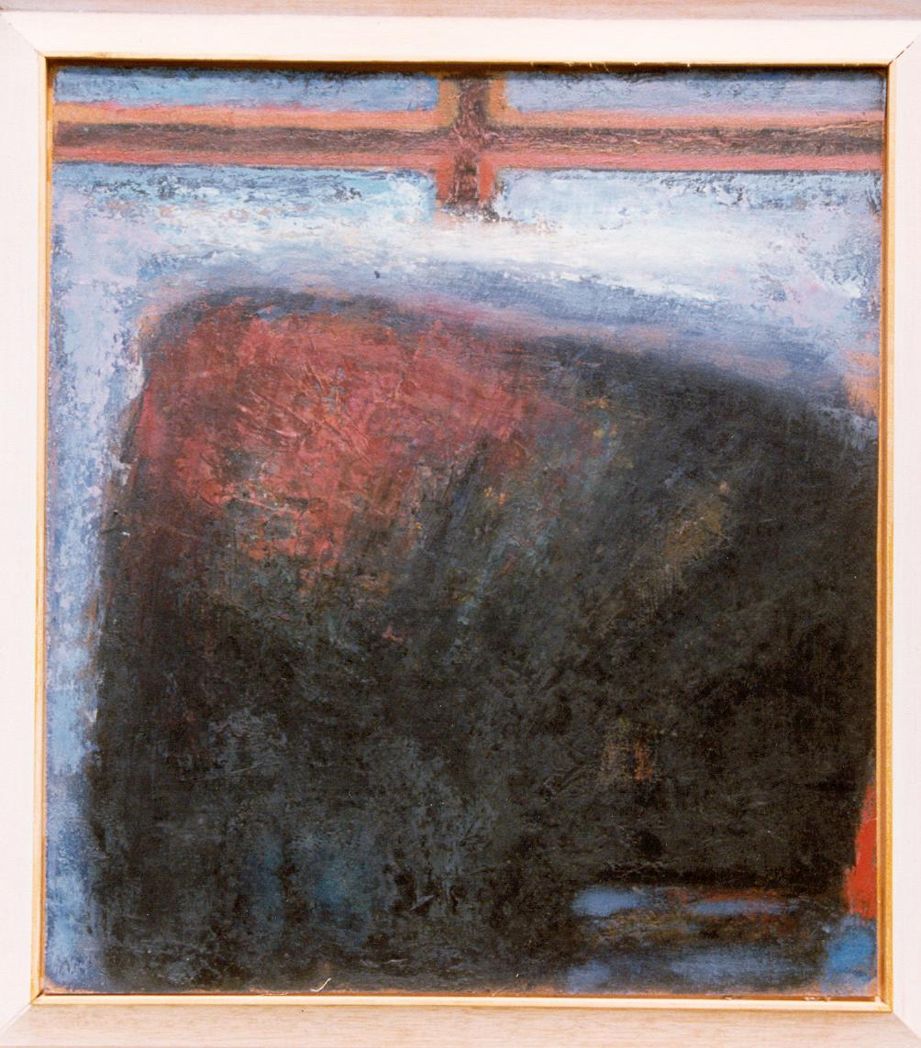
9. Jesus falls a third time

Slide 14
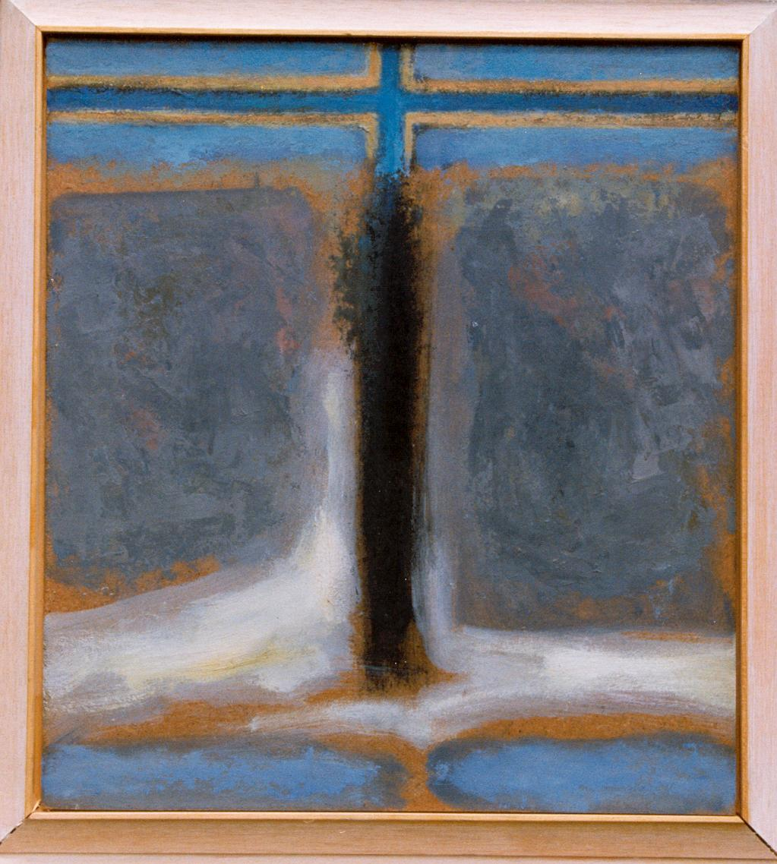
10. Jesus is stripped of his garments

Slide 15
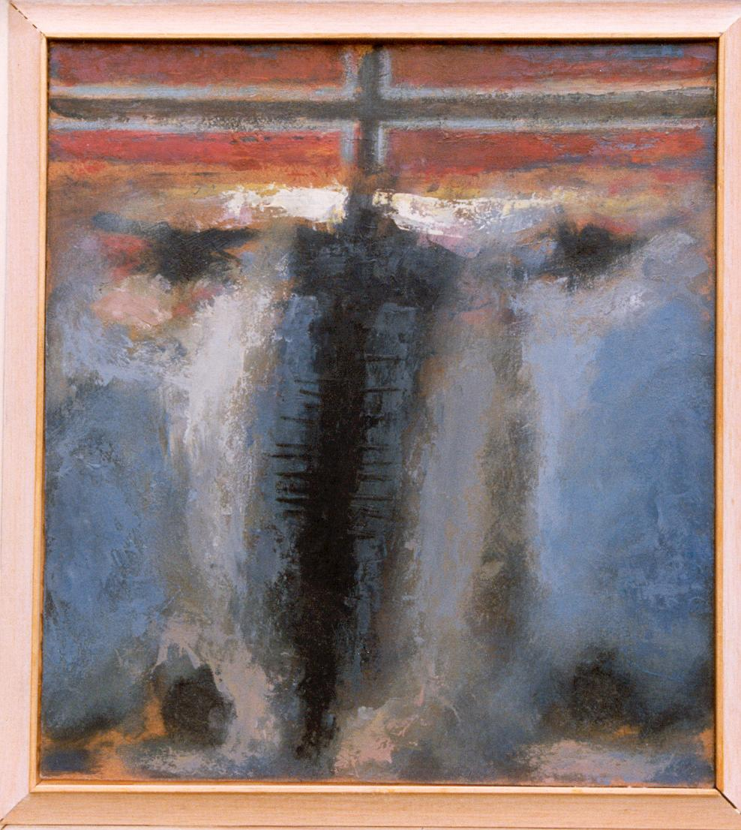
11. Jesus is nailed to the cross

Slide 16
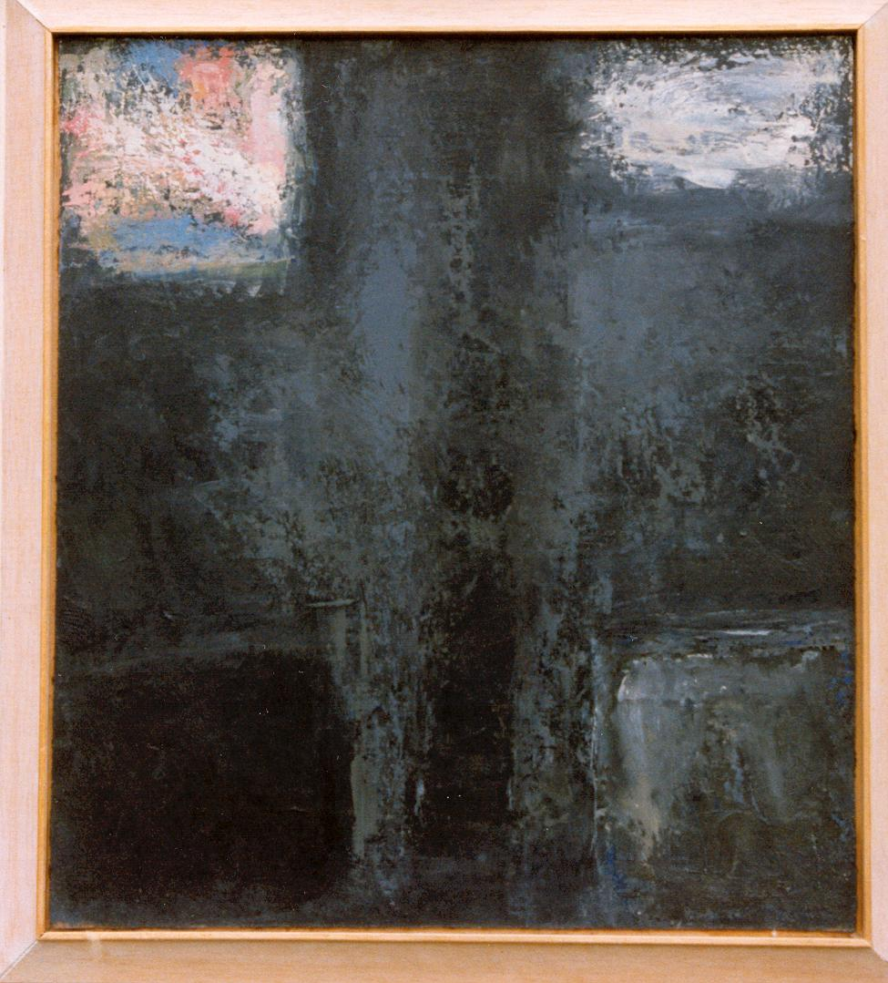
12. Jesus dies on the cross

Slide 17
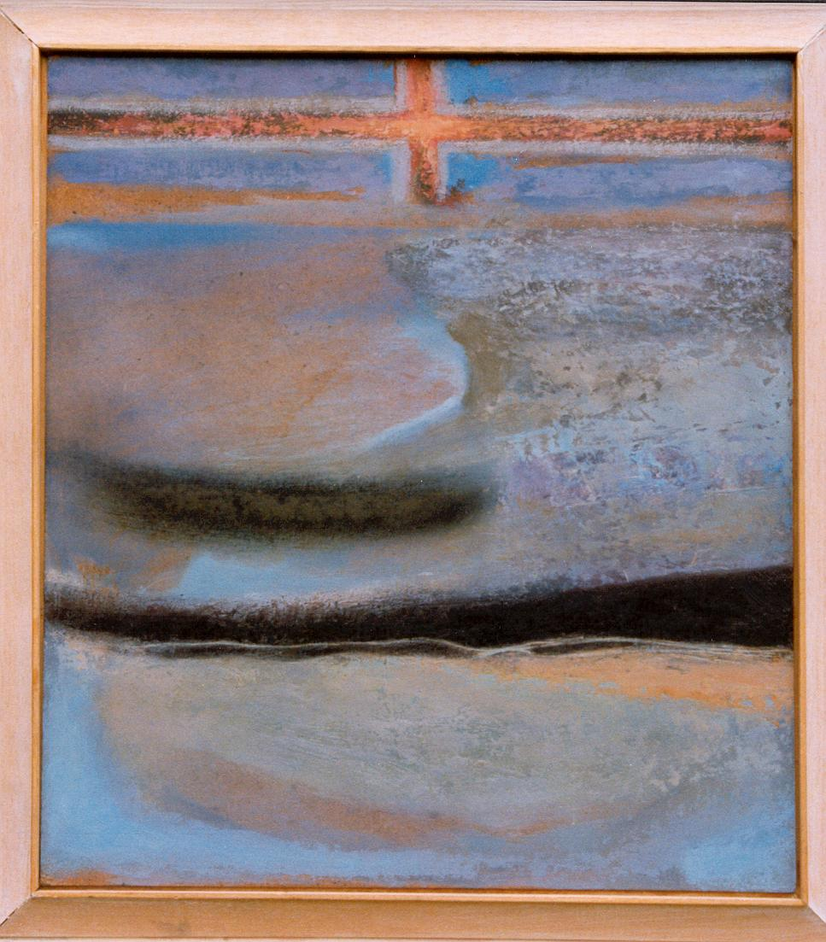
13. Jesus body is taken down

Slide 18
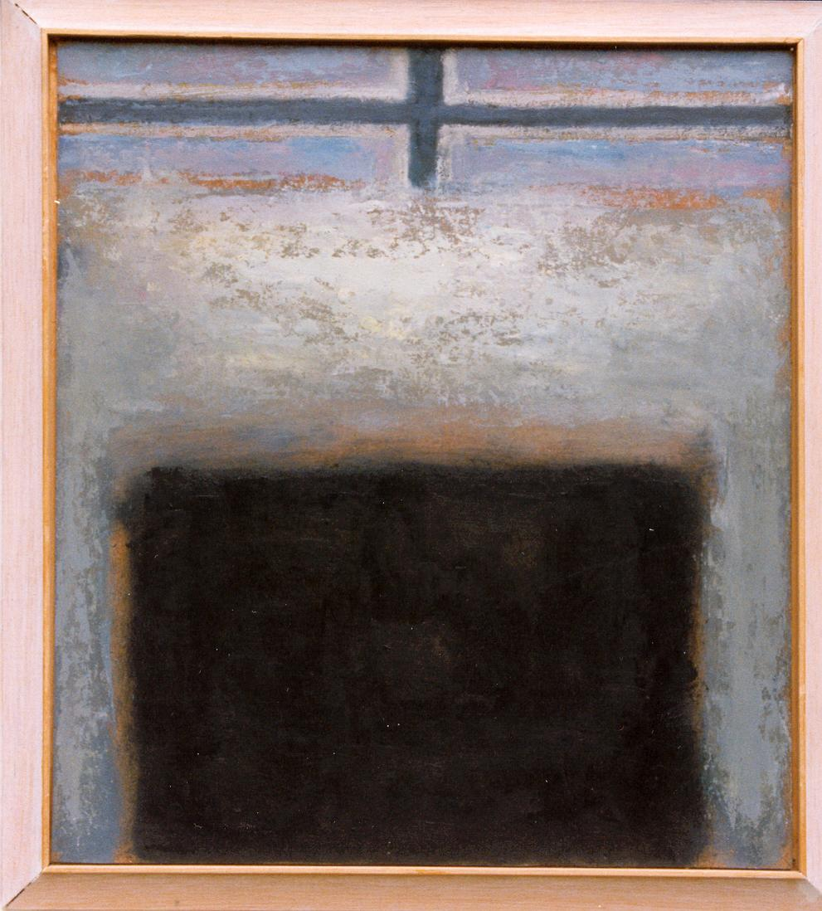
14. Jesus is placed in the tomb

